Slide 1

Natural Language Processing
Taking time into account
Yordan Darakchiev
Technical Trainer
iordan93@gmail.com

Slide 2
sli.do
#DeepLearning

Slide 3
Table of Contents
Time-dependent (sequential) models
  Architecture
  Types
Improvements
Word (token) representations
Refinement algorithms

Slide 4
Time-Dependent Models
"Time is precious, waste it wisely"

Slide 5
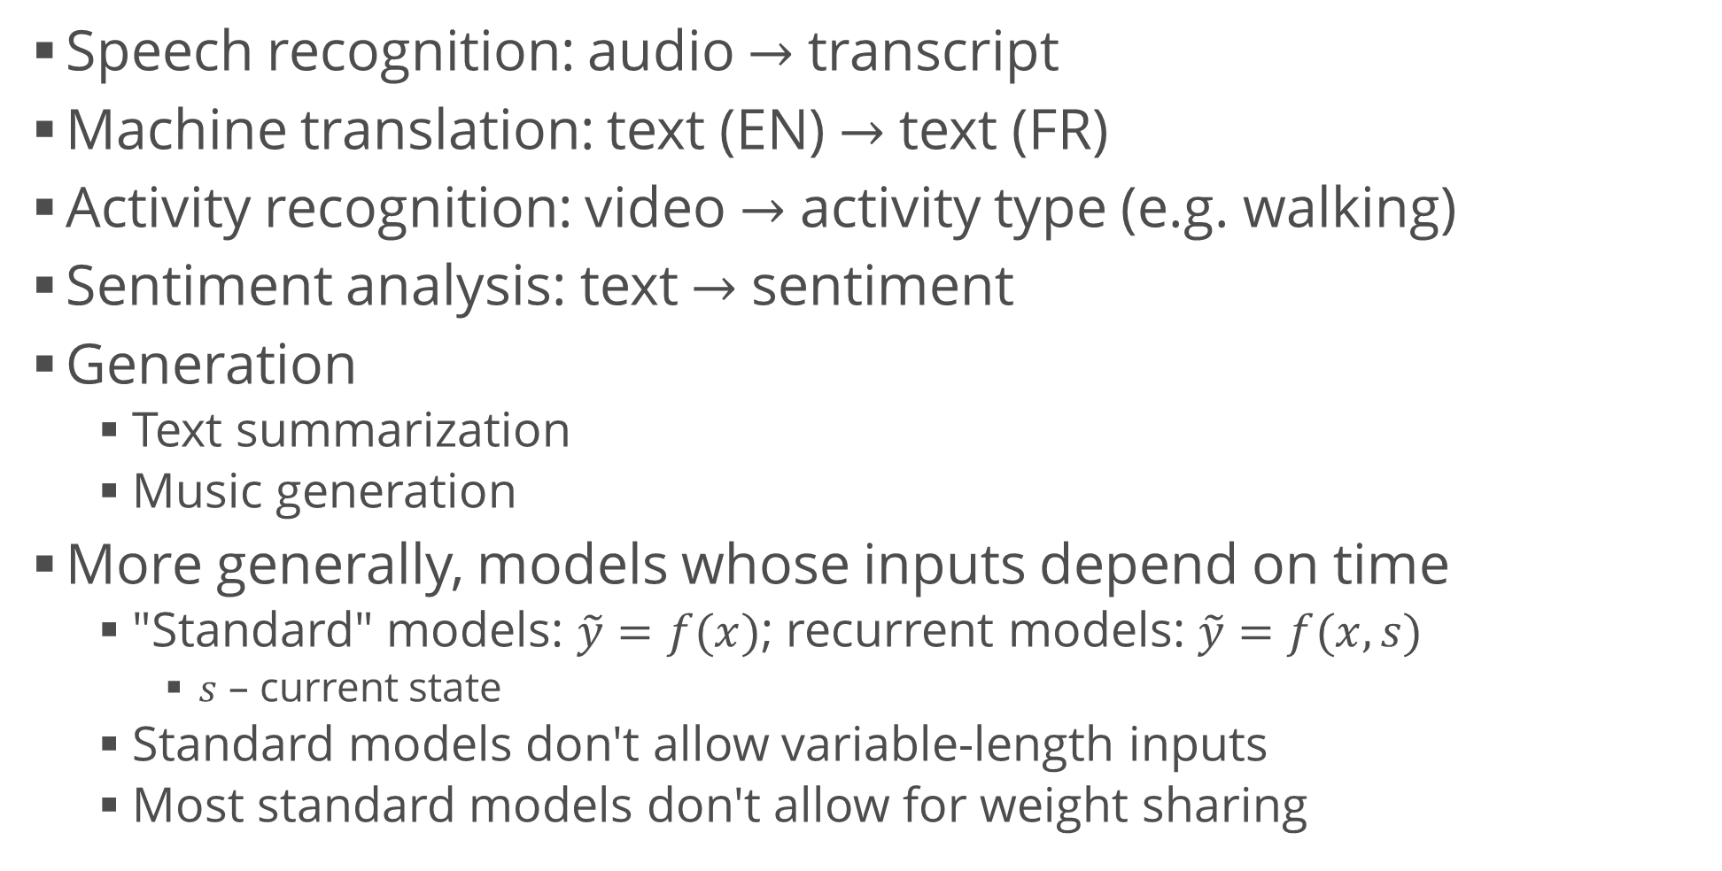
Time-Dependent Model Examples
Speech recognition: audio $→$ transcript
Machine translation: text (EN) $→$ text (FR)
Activity recognition: video $→$ activity type (e.g. walking)
Sentiment analysis: text $→$ sentiment
Generation
  Text summarization
  Music generation
More generally, models whose inputs depend on time
  "Standard" models: $\tilde{y}=f(x)$; recurrent models: $\tilde{y}=f(x,s)$
    $s$ – current state
  Standard models don't allow variable-length inputs
  Most standard models don't allow for weight sharing

Slide 6
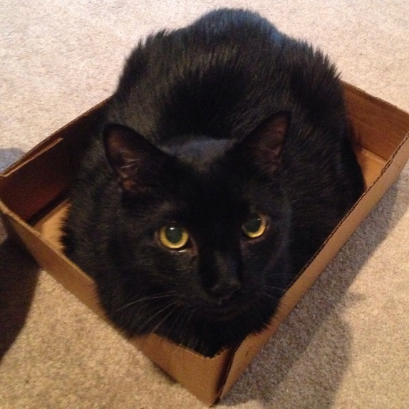




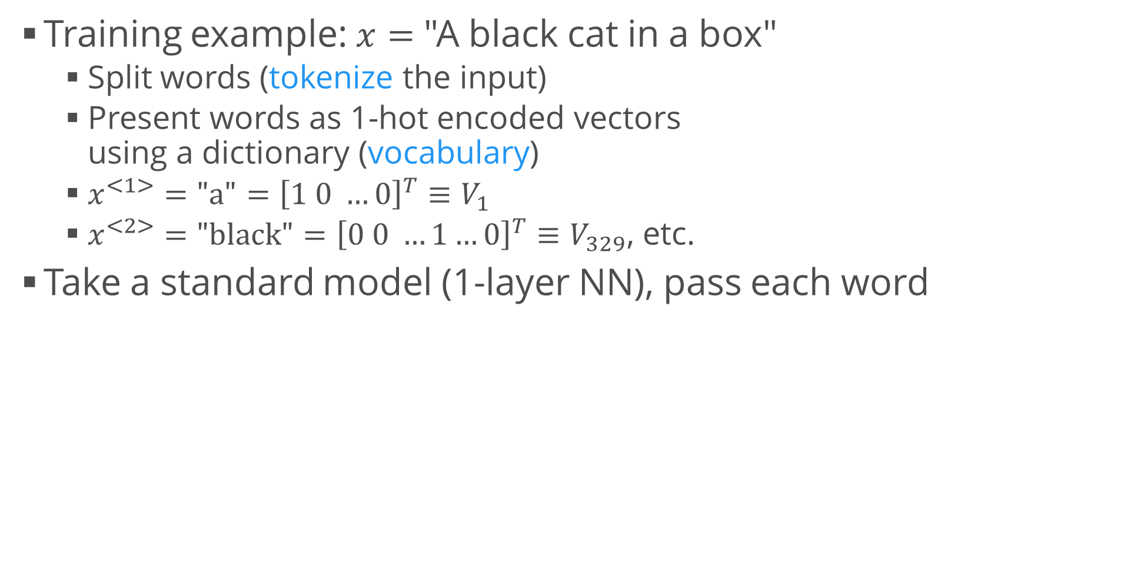









Working with Sequences
Training example: $x=$ "A black cat in a box"
  Split words (tokenize the input)
  Present words as 1-hot encoded vectors
  using a dictionary (vocabulary)
  $x^{<1>}="a"={\left[1 0 …0\right]}^{T}≡V_{1}$
  $x^{<2>}="black"={\left[0 0 …1…0\right]}^{T}≡V_{329}$, etc.
Take a standard model (1-layer NN), pass each word
$$x^{<1>}$$
$$x^{<2>}$$
$$x^{<3>}$$
$$256$$
$$256$$
$$256$$
$$a^{<0>}$$
$$a^{<1>}$$
$$a^{<2>}$$
$$a^{<3>}$$
$${\tilde{y}}^{<1>}$$
$${\tilde{y}}^{<2>}$$
$${\tilde{y}}^{<3>}$$

Slide 7
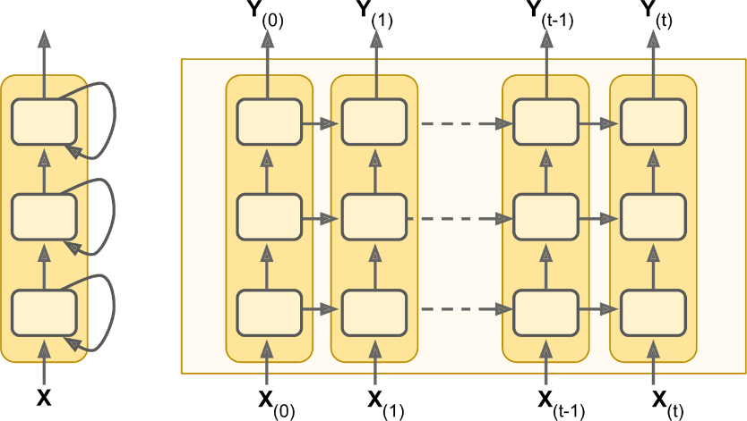
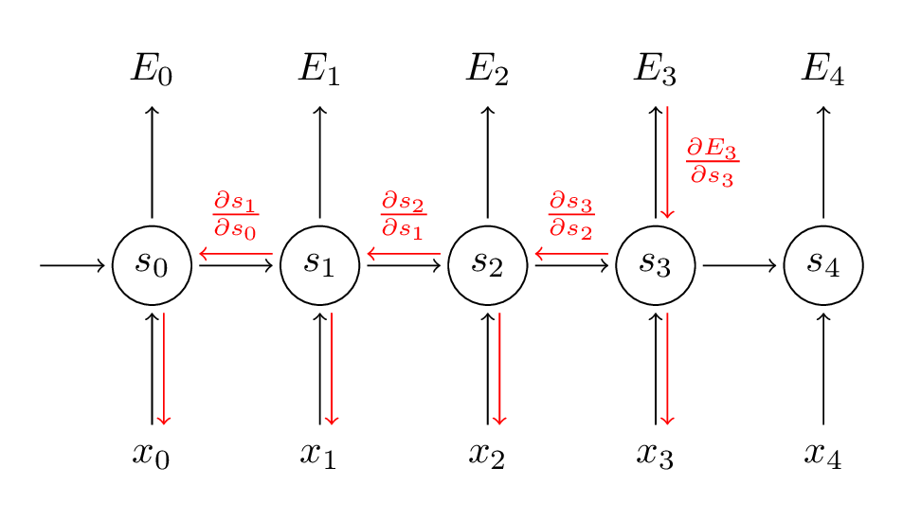







Recurrent Neural Networks
"RNN cell"
Deep architectures are also possible
Learning: backpropagation through time
  The same as in a multi-layer network: $arg min J\left(y^{<t>}, {\tilde{y}}^{<t>}\right)$
$${ a}^{<t−1>}$$
$σ$
$${ a}^{<t>}$$
$$x^{<t>}$$
$σ$
$${\tilde{y}}^{<t>}$$

Slide 8
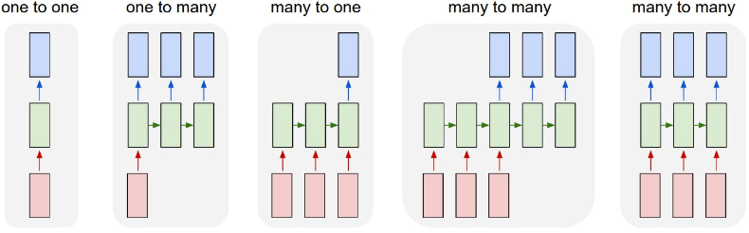
RNN Architectures
One to one: standard
One to many
  Sequence generation given seed (e.g. image captioning)
Many to one
  One output for sequence (e.g. sentiment analysis)
Many to many
  Encoding and decoding (e.g. machine translation)
  Synchronized output
  (e.g. video classification
  for each frame)

Slide 9
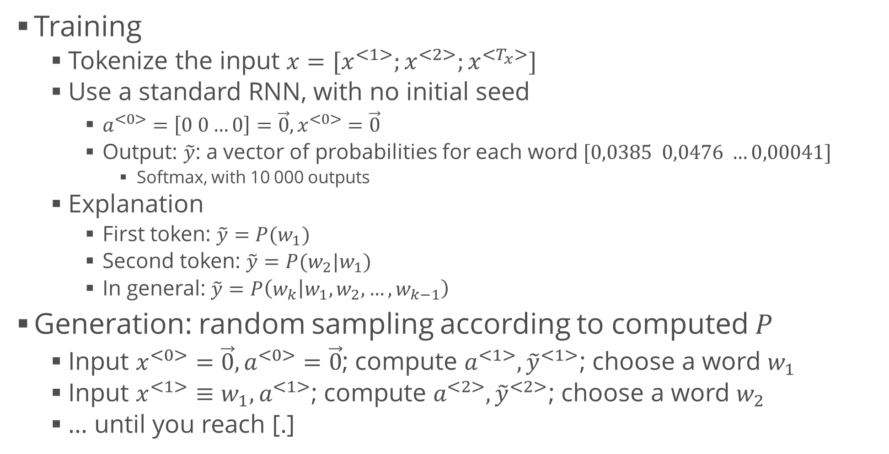
Language Model
Training
  Tokenize the input $x=[x^{<1>};x^{<2>};x^{<T_{x}>}]$
  Use a standard RNN, with no initial seed
    $a^{<0>}=\left[0 0…0\right]=\vec{0}, x^{<0>}=\vec{0}$
    Output: $\tilde{y}$: a vector of probabilities for each word $[0,0385 0,0476 …0,00041]$
      Softmax, with 10 000 outputs
  Explanation
    First token: $\tilde{y}=P(w_{1})$
    Second token: $\tilde{y}=P(w_{2}|w_{1})$
    In general: $\tilde{y}=P\left(w_{k} | w_{1},w_{2},…,w_{k−1}\right)$
Generation: random sampling according to computed $P$
  Input $x^{<0>}=\vec{0},a^{<0>}=\vec{0}$; compute $a^{<1>}, {\tilde{y}}^{<1>}$; choose a word $w_{1}$
  Input $x^{<1>}≡w_{1},a^{<1>}$; compute $a^{<2>},{\tilde{y}}^{<2>}$; choose a word $w_{2}$
  … until you reach [.]

Slide 10
Improved Models
Making things even more difficult

Slide 11
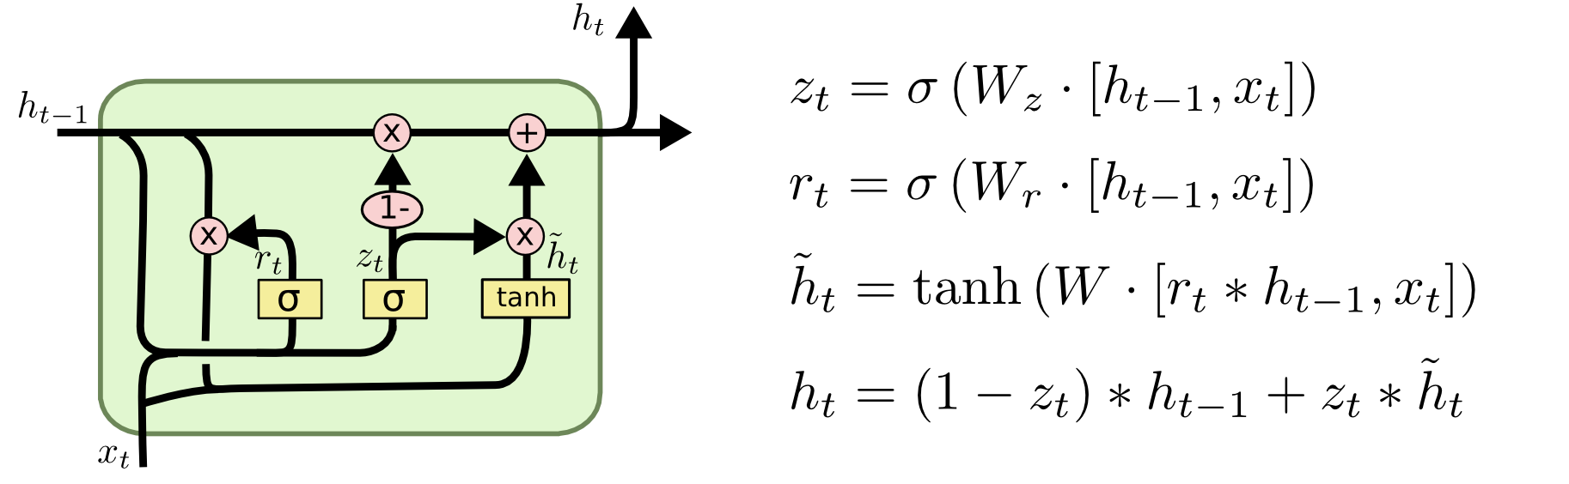
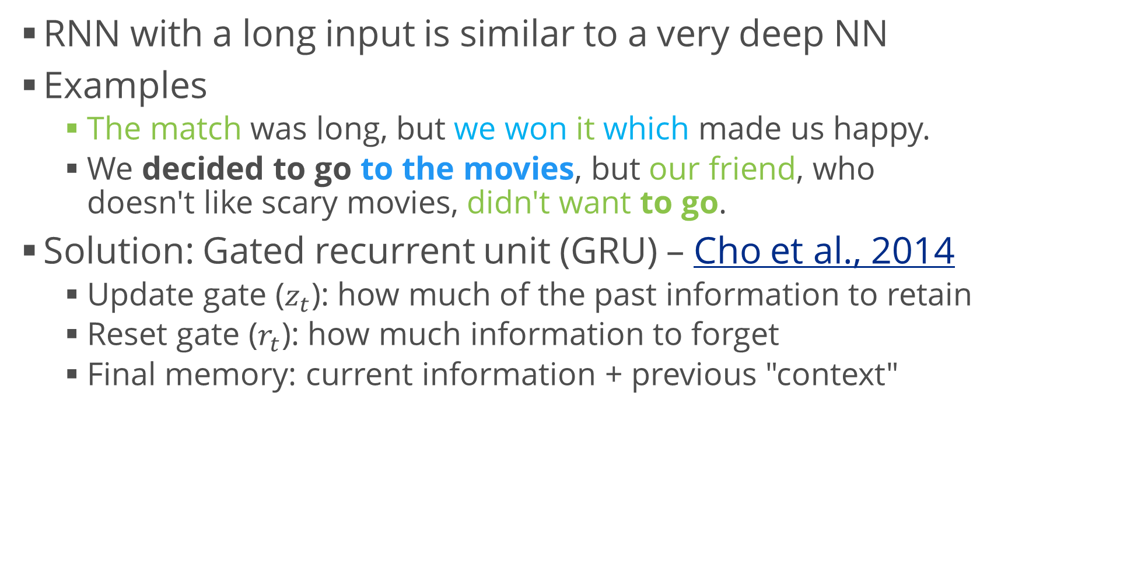
Vanishing Gradients
RNN with a long input is similar to a very deep NN
Examples
  The match was long, but we won it which made us happy.
  We decided to go to the movies, but our friend, who
  doesn't like scary movies, didn't want to go.
Solution: Gated recurrent unit (GRU) – Cho et al., 2014
  Update gate ($z_{t}$): how much of the past information to retain
  Reset gate ($r_{t}$): how much information to forget
  Final memory: current information + previous "context"

Slide 12

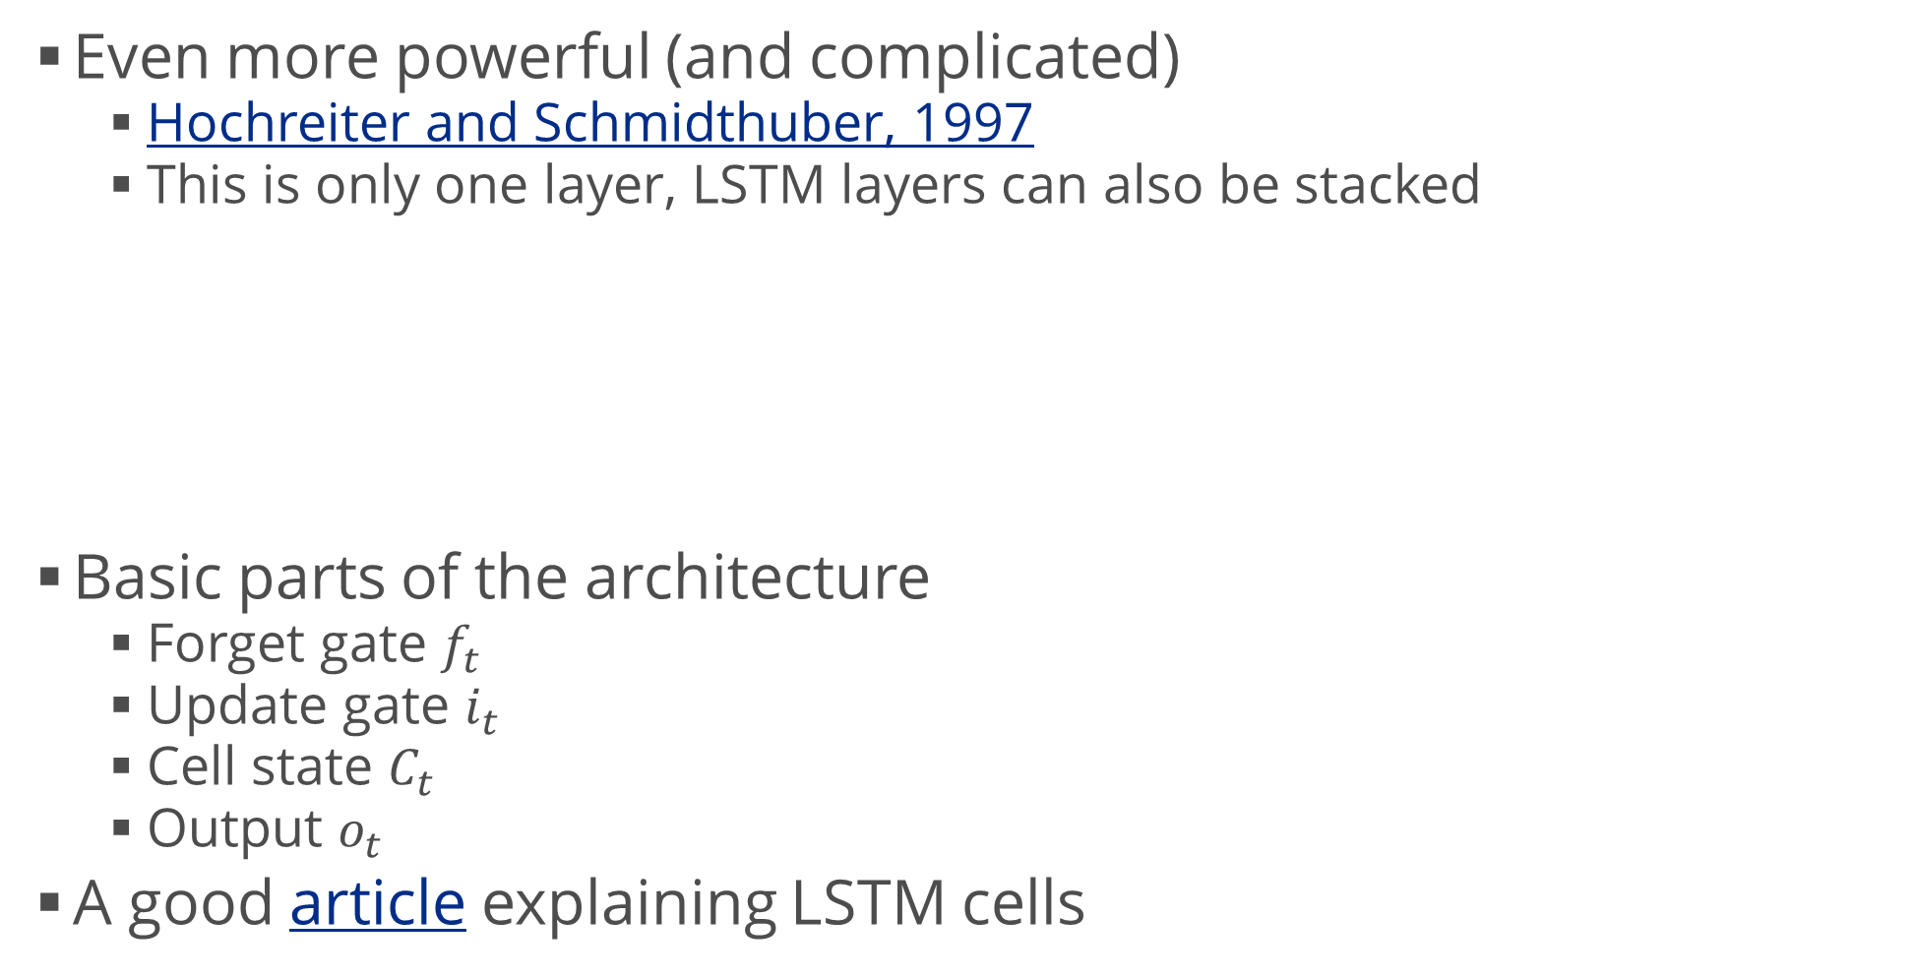
Long-Short Term Memory (LSTM)
Even more powerful (and complicated)
  Hochreiter and Schmidthuber, 1997
  This is only one layer, LSTM layers can also be stacked
Basic parts of the architecture
  Forget gate $f_{t}$
  Update gate $i_{t}$
  Cell state $C_{t}$
  Output $o_{t}$
A good article explaining LSTM cells

Slide 13
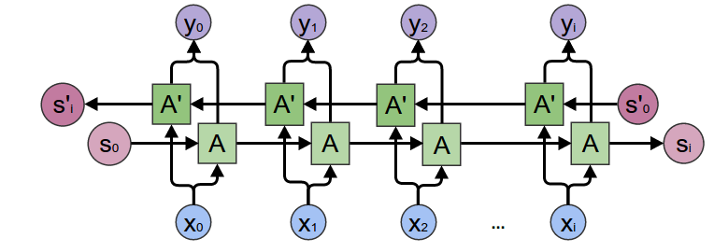
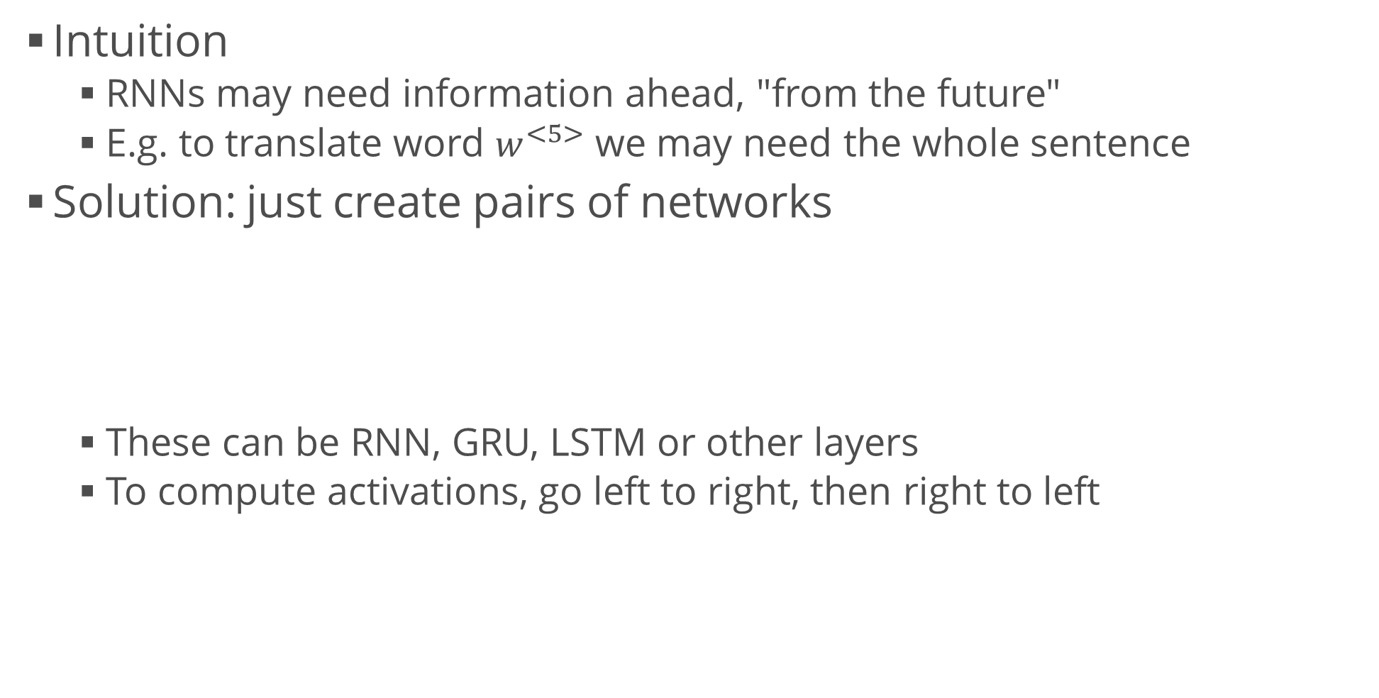
Bi-Directional Networks
Intuition
  RNNs may need information ahead, "from the future"
  E.g. to translate word $w^{<5>}$ we may need the whole sentence
Solution: just create pairs of networks
  These can be RNN, GRU, LSTM or other layers
  To compute activations, go left to right, then right to left

Slide 14
Representing Words
Find your way
in the multi-dimensional space

Slide 15
Word Representation
Basic idea: one-hot encoding
How to get insights on word relations?
  Try to estimate word features: vectors of numbers for each word
    Unsupervised process
    Embedding from a space with one dimension per word
    to a lower-dimensional space (e.g. 300D)
  Example uses
    Use similarity measures (e.g. cosine distance) between vectors
    Use projections to generate analogies (Mikolov et al., 2013)
Visualization: usually t-SNE or PCA
Tensorboard uses Google's Embedding Projector
  https://www.tensorflow.org/guide/embedding

Slide 16
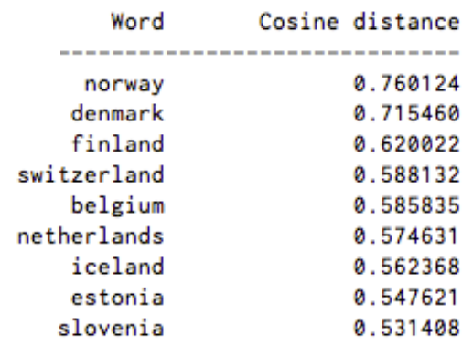
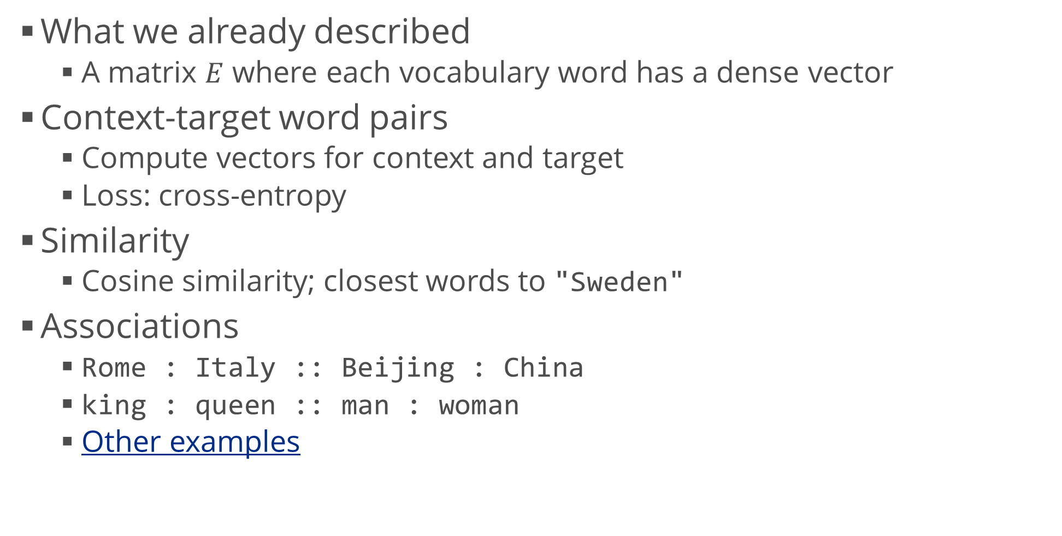
Word2Vec and GloVe
What we already described
  A matrix $E$ where each vocabulary word has a dense vector
Context-target word pairs
  Compute vectors for context and target
  Loss: cross-entropy
Similarity
  Cosine similarity; closest words to "Sweden"
Associations
  Rome : Italy :: Beijing : China
  king : queen :: man : woman
  Other examples

Slide 17
Refinement Algorithms
Some more tricks up our sleeves

Slide 18
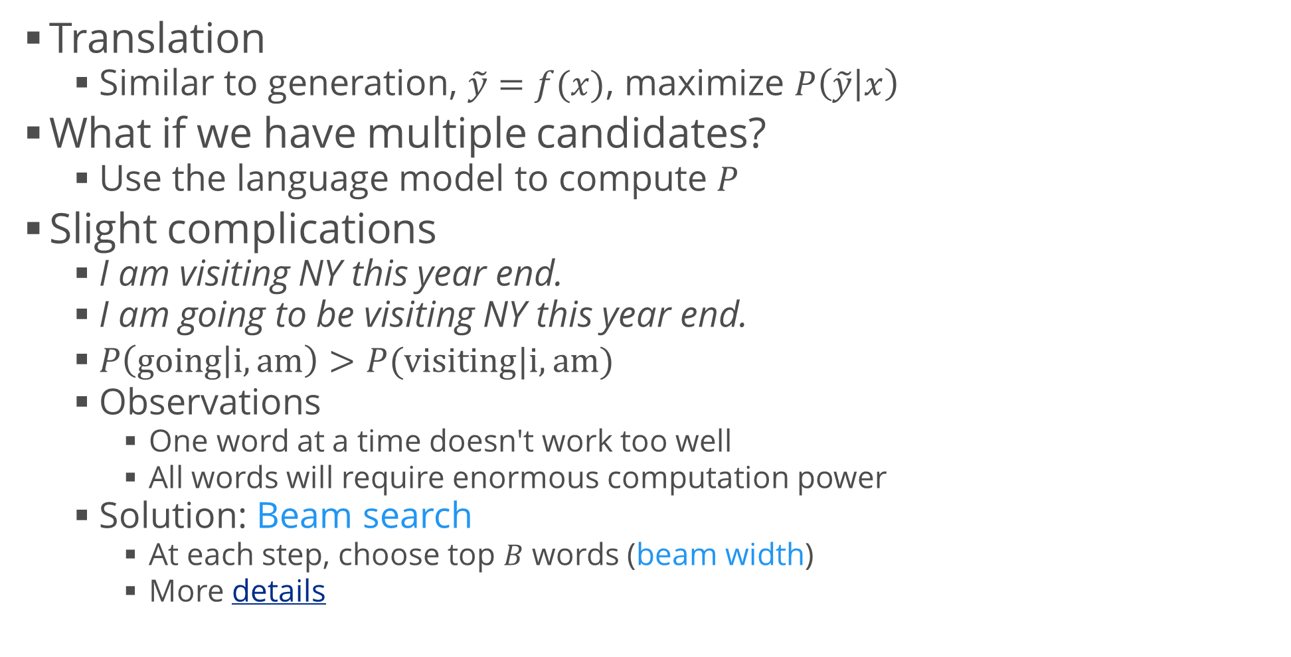
Beam Search
Translation
  Similar to generation, $\tilde{y}=f(x)$, maximize $P\left(\tilde{y} | x\right)$
What if we have multiple candidates?
  Use the language model to compute $P$
Slight complications
  I am visiting NY this year end.
  I am going to be visiting NY this year end.
  $P\left(going | i,am\right)>P(visiting|i,am)$
  Observations
    One word at a time doesn't work too well
    All words will require enormous computation power
  Solution: Beam search
    At each step, choose top $B$ words (beam width)
    More details

Slide 19
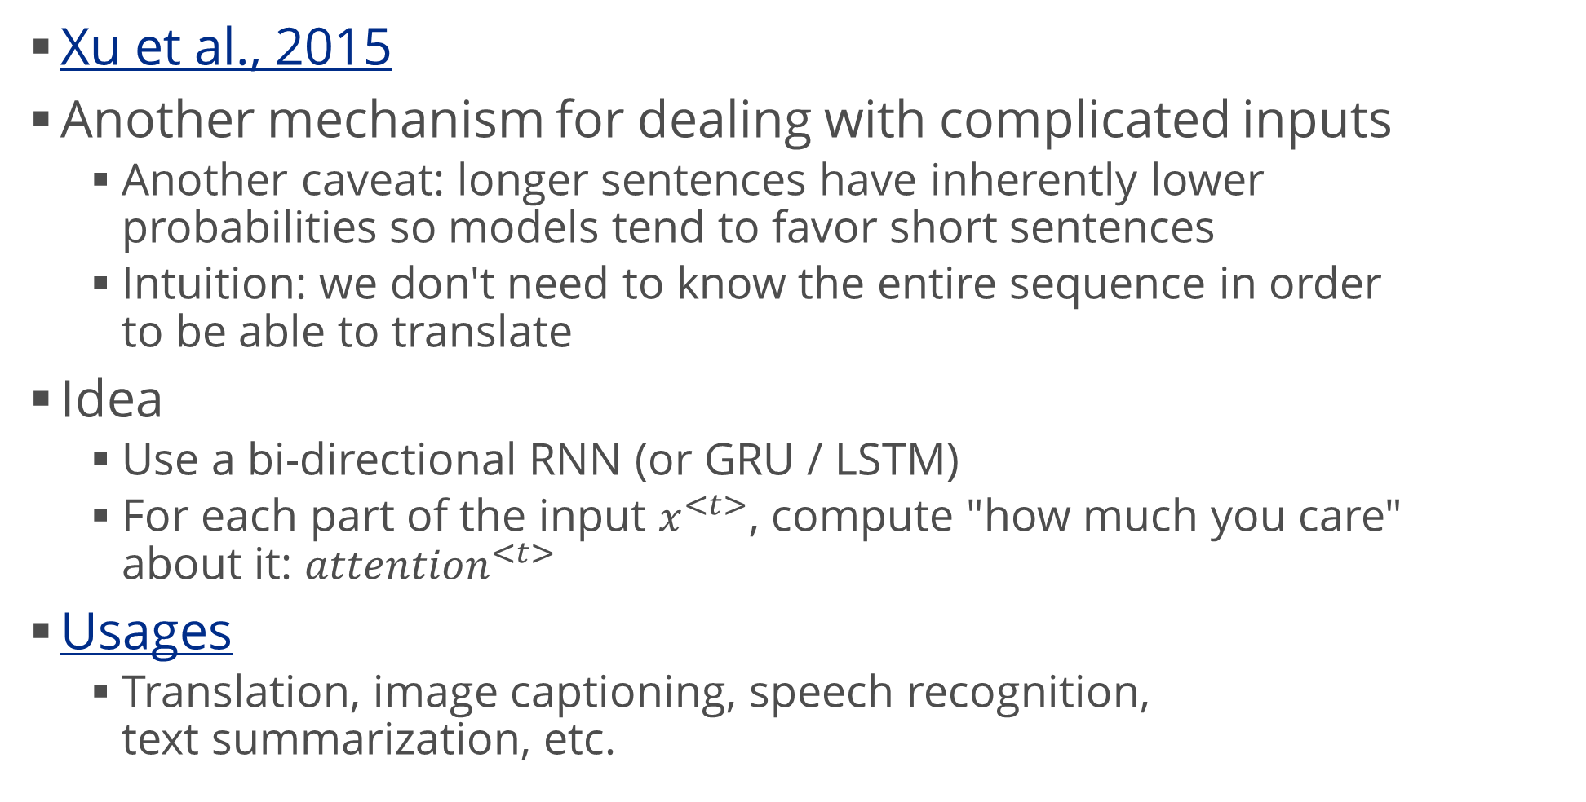
Attention
Xu et al., 2015
Another mechanism for dealing with complicated inputs
  Another caveat: longer sentences have inherently lower
  probabilities so models tend to favor short sentences
  Intuition: we don't need to know the entire sequence in order
  to be able to translate
Idea
  Use a bi-directional RNN (or GRU / LSTM)
  For each part of the input $x^{<t>}$, compute "how much you care"
  about it: ${attention}^{<t>}$
Usages
  Translation, image captioning, speech recognition,
  text summarization, etc.

Slide 20
Summary
Time-dependent (sequential) models
  Architecture
  Types
Improvements
Word (token) representations
Refinement algorithms

